Slide 1
Spanish Style House
By: Timothy Rigney

Slide 2
About Spanish Style Houses
Spanish home plans may feature towers or turrets, romantic balconies, fancifully shaped columns, and wrought iron details.
Spanish home plans are most popular in Florida, Texas, Arizona, New Mexico, and California, though elements of the style may appear in homes all over the country.
Residential houses mostly.
One or Two stories
Materials: stone, wood, and different types of tiles
Developed by Bertram Goodhue in 1915

Slide 3
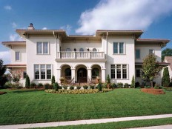
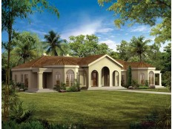

Characteristics of Spanish Style House
Romantic balconies
Fancy columns
Tower
Iron detail

Slide 4
Sources
http://www.dreamhomesource.com/house-plans/dhs/styles/southwest-house-plans/spanish-style-house-plans.html
http://en.wikipedia.org/wiki/Spanish_Colonial_Revival_architecture

