Slide 1
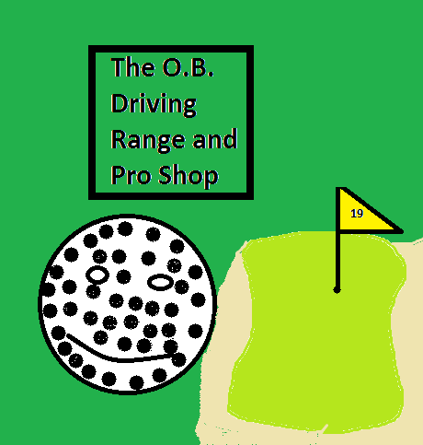
The O.B. Driving Range and Pro Shop
Opening Day !!!!!!
Reduced cost for new members signing up on opening day.
Open from 8 am-6 pm
December 20, 2013
Indoor driving range simulator with putting green.
Full pro shop.
Certified fitting center.
Lessons.
Club maintenance.
Buy and sell pre owned clubs.

